Slide 1
Naive Bayes Algorithm

Slide 2
What is Naive Bayes Classifier?
Naive Bayes is a statistical classification technique based on Bayes Theorem. It is one of the simplest supervised learning algorithms. Naive Bayes classifier is the fast, accurate and reliable algorithm. Naive Bayes classifiers have high accuracy and speed on large datasets.
Here is the Formula of Naïve

Slide 3

P(h): the probability of hypothesis h being true (regardless of the data). This is known as the prior probability of h. P(D): the probability of the data (regardless of the hypothesis). This is known as the prior probability. P(h|D): the probability of hypothesis h given the data D. This is known as posterior probability. P(D|h): the probability of data d given that the hypothesis h was true. This is known as posterior probability.

Slide 4
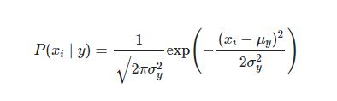
What is Gaussian Naive Bayes?
In Gaussian Naive Bayes, continuous values associated with each feature are assumed to be distributed according to a Gaussian distribution. A Gaussian distribution is also called Normal distribution.

Slide 5
Results of Naive Bayes
Byte Count = 66.11
Size = 50.35
ASM Operators = 80.21
Section Count = 53.05
Size + Byte Count = 80.58
Size + Section Count = 53.05
Section Count + Byte Count = 65.37
Size + Section Count + Byte Count = 65.37
Size + Section Count + Byte Count + ASM Operators = 85.03

Slide 6
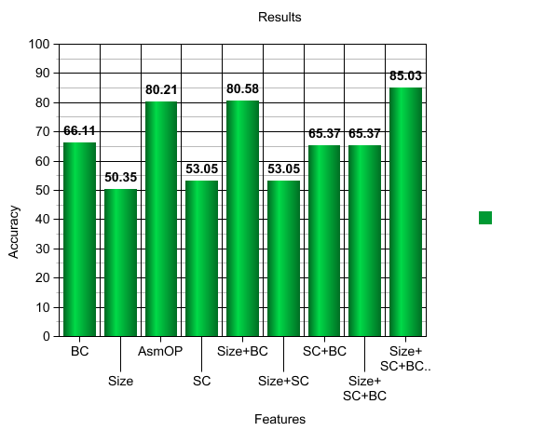
Graphical Representation

